Slide 1
ASP.NET MVC SPA

Slide 2
Overview
Application requirements brainstorming
Introduction to ASP.NET MVC project
Setting up the solution
Accessing data with EF
Improving the design with patterns
Unit testing
JavaScript introduction
JavaScript libraries
Goint to SPA ☺

Slide 3
Setting up the solution

Slide 4
N-Tier architecture
Divide scope into 3 tiers
Presentation Layer
Business Layer
Data Layer

Slide 5
Business Layer
Command pattern
Called by PL
CommandInvoker, central entry point for execution of command
Base classes, Command, CommandResult, CommandReceiver/Handler

Slide 6
DataLayer
DataAccessObjects
DataContext
IDataContext

Slide 7
Accessing data with EF

Slide 8
Improving the design with patterns

Slide 9
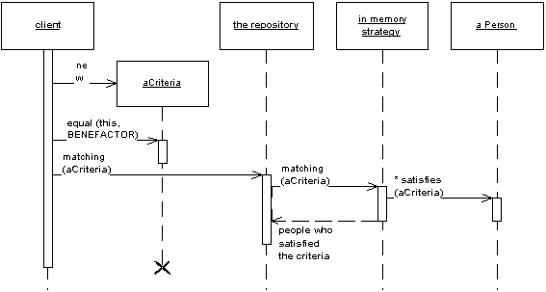
Patterns
RepositoryPattern

Slide 10
Patterns
RepositoryPattern
encapsulates the set of objects persisted in a data store and the operations performed over them, providing a more object-oriented view of the persistence layer.
supports the objective of achieving a clean separation and one-way dependency between the domain and data mapping layers.
allows you to choose the DAL technology that fits the current use case.
Do not add anything into the repository class until the very moment that you need it
Domain (business) entities vs DAL entities?
Beware
Do not expose LINQ methods
Learn about lazy loading
ToList() before returning
Get is not search

Slide 11
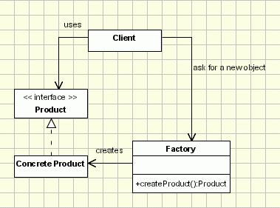
Patterns
FactoryPattern

Slide 12
Patterns
FactoryPattern
-“new” keyword, under the hood you are introducing coupling within your application
-define abstractions (abstract classes, interfaces)
-isolate creation and move it to a dedicated class called Factory

Slide 13
Libraries
Loggers
-logging of different types of messages
-existing libraries (Log4Net, NLog)
IoC container
-containers used to implement the Dependency Inversion principle
-existing libraries (Autofac, Ninject, Unity …)

Slide 14
Unit testing

Slide 15
Introduction
Testing Methods
Levels of Testing
Testing Practices and Methodologies
What is UnitTesting?
Unit Testing Frameworks

Slide 16
Test double patterns
Test Stub
Test Spy
Mock Object
Fake Object

Slide 17
MSTest framework
Attributes
Attributes Used to Identify Test Classes and Methods (Example 01)
TestClassAttribute
TestMethodAttribute
Attributes Used to Establish a Calling Order (Example 01)
AssemblyInitializeAttribute (Don’t use in ASP.NET tests)
AssemblyCleanupAttribute (Don’t use in ASP.NET tests)
ClassInitializeAttribute (Don’t use in ASP.NET tests)
ClassInitializeAttribute (Don’t use in ASP.NET tests)
TestInitializeAttribute
TestCleanupAttribute
Attributes for Identifying and Sorting Tests (Example 01)

Slide 18
MSTest framework
Asserts and Exceptions (Example 02)
Assert statements are the basic way of specifying the conditions under which the executed code should pass or fail.
Asserts are basically classes that expose a number of static methods that perform comparisons of values against known conditions and according to the result allow the call to pass without an error or throw an AssertFailException to signal failure.
Assert- Verifies conditions in unit tests using true/false propositions
CollectionAssert- Verifies true/false propositions associated with collections in unit tests
StringAssert-Verifies true/false propositions associated with strings in unit tests
ExpectedExceptionAttribute-Indicates that an exception is expected during test method execution.

Slide 19
MSTest framework
Using Visual Studio to write tests (Lab)
Add test project (use <SolutionName>.Tests.<TypeOfTests> convention)
Add tests
Use the Add New Test Option
Use the Add Unit Test Option
Use the Create Unit Tests… Option
Use the Add New Item option and create the class manually
Test Properties (Owner, Description,TestProperty…)
Configure Tests
Manage Test Configurations
Manage Test Metadata (Test Lists)
Run/Debug Tests
Gather Code Coverage

Slide 20
JavaScript introduction

Slide 21
JavaScript libraries

Slide 22
Going to SPA

